Slide 1
“പ്രാർത്ഥനയിൽ ഉറ്റിരിപ്പിൻ; സ്തോത്രത്തോടെ അതിൽ ജാഗരിപ്പിൻ” കൊലൊസ്സ്യർ 4:2
“Continue in Prayer and Watch in the same with Thanksgiving..”
Colossians 4:2

Slide 2


Slide 3


Slide 4


Slide 5
FRAN PRAYER

Slide 6
Prayer For Neighbors

Slide 7
SRA 1 S. Vijayakumaran Nair
SRA 1A K.C. Cherian
SRA 1B N. Radhakrishna Kurup
SRA 1B(1) Sasikumar. T.S
SRA 1C S. Venugopal

Slide 8
SRA 1 D S. Gopakumar
SRA 1E M. Aliyarkunju
SRA 1F A. Aji Kumar
SRA 2 Dr. M.N.C. Bose
SRA 3 Dr. K. Jayaram Das

Slide 9
SRA 4 N. Radhakrishna Kurup
SRA 4A K. Harikrishnan
SRA 5 P.K. Gopalakrishnan Nair
SRA 6 Padmavathy Amma
SRA 6A Dr. Radhakrishnan. R

Slide 10
SRA 7 Asha S. Nair
SRA 7A Jayachandran. T.R
SRA 8 C. Divakaran Nair
SRA 9 N. Rajagopalan Nair
SRA 9A Jyothish. R

Slide 11
SRA 9B Dr. N. Mukundan
SRA 9C Sreenath. U.L
SRA 10 N. Ajith Kumar
SRA 10A Premachandran
SRA 10B K. Biju Kumar

Slide 12
SRA 11 Jayaram Das. G
SRA 11A Rajeswari Gopimohan
SRA 12 K. Mohan Das
SRA 12A Sreekala Karunakaran
SRA 14 Jyothi. K.B

Slide 13
SRA 15 K. Premachandran
SRA 15A Jayakumaran. T
SRA 16 Vinu V. Nair
SRA 17 Ramachandran Nair. G
SRA 17A Sajesh Kumar. S.P

Slide 14
SRA 18 Dr. G. Radhakrishna Kurup
SRA 18A Anil Kumar. R
SRA 19 G. Gopakumar
SRA 20/21 D. Christudas
SRA 22 G. Satheesh Kumar

Slide 15
SRA 23 Harikumar
SRA 24 Sreekanth. S
SRA 25A George Mathews
SRA 26 Dr. James George
SRA 27 Jayakumaran. T

Slide 16
SRA 28
SRA 29 T. Madhavan Nair
SRA 30
SRA 31 Mathew Roshan
SRA 32 Rafeek. A

Slide 17
SRA 33A Rajan Pilla
SRA 33B P. Omana
SRA 34 D. Jayakumari
SRA 34A Udayakumar. B
SRA 34B Santhosh Kumar. B

Slide 18
SRA 33A Rajan Pilla
SRA 33B P. Omana
SRA 34 D. Jayakumari
SRA 34A Udayakumar. B
SRA 34B Santhosh Kumar. B

Slide 19
SRA 34C Santhosh Kumar
SRA 35 K. Chandrasekharan Nair
SRA 35A Anoop B. Krishnan
SRA 36 K. Vijayakumar
SRA 36A Sreejith. P.C

Slide 20
SRA 36B Anand. A
SRA 36C Arun Raj. R
SRA 37 K. Viju
SRA 38 Satheesh. R
SRA 38A Rajeev. R

Slide 21
SRA 38B K. Gilbert
SRA 40 Ramachandran Nair. K
SRA 41 Reghunath. N
SRA 41B Vijayakumaran Nair. V
SRA 41C Sreedharan Pillai

Slide 22
SRA 42
SRA 44 Sivanandan. L
SRA 45 R. Ravindranathan Nair
SRA 45A Rajagopal. N
SRA 45B M. Eswaran

Slide 23
SRA 45C V. Gita Devi
SRA 45D S. Ramesan
SRA 45E Balagopal. K
SRA 45F Alexander. K.J
SRA 45G Vaishakh. B.P

Slide 24
SRA 45H Vijai Raj. R
SRA 46 T. Antony
SRA 47
SRA 48 Jacob. K.P
SRA 49 Thomas Mathew

Slide 25
SRA 50 C. Ajith
SRA 51 Varughese. G
SRA 51A Antony Martin
SRA 52 P. Sivadasan
SRA 53 P. Anilkumar

Slide 26
SRA 54 Biju Narayanan
SRA 55 Vijayan. P
SRA 56 P.N. Anil
SRA 57 Chandran
SRA 58 Saji. A.S

Slide 27
SRA 59 Manjusha Rajesh
SRA 60 V. Mohana Nathan Nair
SRA 61 V. Rajendran Nair
SRA 72 Gireesan Nair
SRA 72A V. Muraleedharan Nair

Slide 28
SRA 73 V. Ravindra Nathan Nair
SRA 74 K. Shankunni
SRA 75 Thimothy Francis. C
SRA 76 Vinod Skaria
SRA 77 Eldhose T. Yacob

Slide 29
SRA 78 Omana. K.M
SRA 78A Vineeth. V
SRA 79 Balakrishnan. P
SRA 80 B.J. Vijayan
SRA 81

Slide 30
SRA 82 Sheela. A
SRA 82B
SRA 84A Dr. P.V. Joy
SRA 84B Syamala. K.S
SRA 84C V.J. Zacharia

Slide 31
SRA 84D Santhosh. J
SRA 85
SRA 85A Abdul Salim
SRA 85B A. Nazar
SRA 85C Tim Chacko Thomas

Slide 32
SRA 86 Samson. S.N
SRA 86A Jase Varghese, ICPF
SRA 86B Vijayan. P
SRA 87
SRA 87A

Slide 33
SRA 88 Soman
SRA 89 S Johnson
SRA 90 Madhusumanan
SRA 91 Nelson(S David)
SRA 92 Rajan

Slide 34
SRA 93 Babusenan. S
SRA 94 Josekutty Job
SRA 95 Dr. Aneesh. A
SRA 96 M.A. Abraham
SRA 97/98

Slide 35
SRA 201 Suresh Kumar. R
SRA 202 P.S. Santhosh Kumar
SRA 203 Dr. Rabi. A
SRA 204 K. Radhakrishnan Nair
SRA 205 Dr. C. Mohanan

Slide 36
SRA 206 S.K. Asokan
SRA 207 S. mohanan Asari
SRA 208 R. Padmavathi Amma
SRA 209
SRA 210 Arifa Beevi. M

Slide 37
SRA 211 Subiraj. A
SRA 212 Babitha. A
SRA 213 Thankamani. L
SRA 214 Babu. S
SRA 215 Thulasidharan. S
SRA 216 Ambi. V

Slide 38
SRA 301/302
SRA 303 Praveen. M.D
SRA 304 Christopher. S
SRA 305 Byju. C
SRA 305A Gopi. P.U

Slide 39
SRA 305B K. Santhini
SRA 306 Aravindan. R
SRA 307
SRA 308 Prof. M.J. George
SRA 309 Vijayagopal

Slide 40
SRA 310 Sasi. S
SRA 311 New
SRA 312 S. Savithri
SRA 313 Aliyamma Joshua
SRA 314 IPC Sreekariyam

Slide 41
SRA 315 Jose Mathew
SRA 316
SRA 317 John Sundar
SRA 318 New
SRA 319 New

Slide 42
SRA 401
SRA 402 K.N. Vijayamma
SRA 403 Prem Kumar. A
SRA 404 P. Arumugam Asari
SRA 405 T.T. Thomas

Slide 43
SRA 406 V. Manmadhan Nair
SRA 407 K.N. Vijayamma
SRA 407A Naveen
SRA 408
SRA 409 Biju Parameshwaran

Slide 44
SRA 410 C. Babu
SRA 411 W. Minimol
SRA 412 Senthil Kumar. A
SRA 412A Vijaya Chandran. A
SRA 413 M. Radhakrishnan Nair

Slide 45
SRA 414 Biju. G.R
SRA 414A Santhibhavanam
SRA 414B P.M. Philip
SRA 414C Sreejith. V
SRA 415 Ushakumari. S

Slide 46
SRA 415A Aneesha. S.L
SRA 416 Leela. L
SRA 417 Vijayan. G
SRA 418 Shibu Kumar. A
SRA 419 Mahesh. G

Slide 47
SRA 420 Sunny George
SRA 421 Mohanan Nair. K
SRA 422 Sukumaran Nair. K.S
SRA 423 K. Manoharan Nair
SRA 424 Anoop. B.S

Slide 48
SRA 425 Premkumar. P.N
SRA 426 K. Sundara Raj
SRA 426A R. Prasobhan
SRA 426B Dr. Manojkumar. G
SRA 427

Slide 49
SRA 428 N.G. Balakrishnan
SRA 428A Bobby
SRA 428B
SRA 429 Dr. B. Unnikrishnan Nair
SRA 430

Slide 50
SRA 431 Ramakrishnan. G
SRA 432/433
SRA 434 Archana Anil
SRA 435 Vijaya Kumaran Nair
SRA 436 K. Manikandan Nair

Slide 51
SRA 437/438
SRA 439 Gopi. V
SRA 440 Vasantha Amma. A
SRA 440A Deepu. R
SRA 441 Syam Prasad. P

Slide 52
SRA 441A Prabhakaran Nair
SRA 442 G. Raman Nair
SRA 443 Vijayakumaran Nair
SRA 444 K. Leela Kumari
SRA 444A Muraleedharan Nair. G

Slide 53
SRA 445 Saraswathi Amma
SRA 445A
SRA 446
SRA 447 Sudhakaran. S
SRA

Slide 54
SRA 501 S Jayakumaran Nair
SRA 502 Premnath K.S
SRA 503/504/505
SRA 506 KP Gopinadhan Pillai

Slide 55
SRA 507 Adv.Aniyoor T Ajithkumar
SRA 508/512
SRA 509 S Karunakaran Nair
SRA 510 R NandhaKumar
SRA 511 G Asok Kumar

Slide 56
SRA 516 Saseendran Nair
SRA 517 K. Gopalan Nair
SRA 518 R. Radharemanan
SRA 518A R. Sambathkumar
SRA 519 Sanal Kumar S

Slide 57
SRA 601 James Joseph
SRA 602 A.C. Oommen
SRA 603 Jayakumar G
SRA 604 Manju S

Slide 58

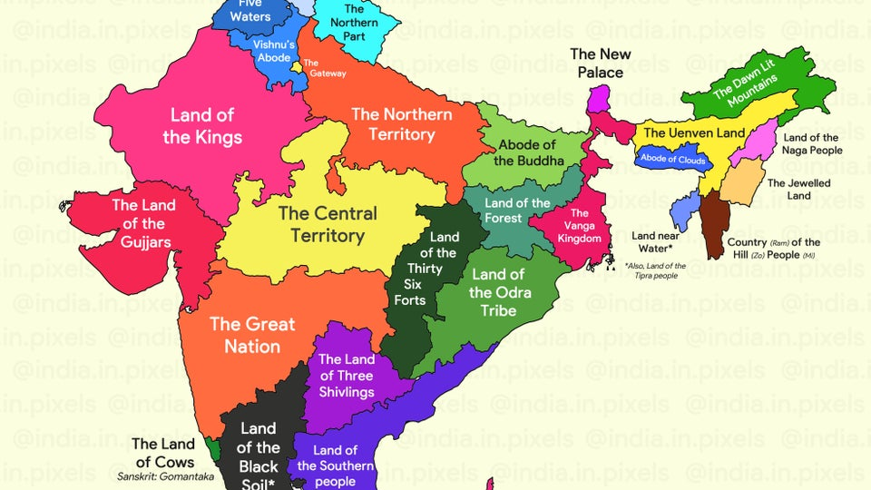
God Bless India!

